Slide 1

Affine Loop Optimization using Modulo Unrolling in CHAPEL
Aroon Sharma, Joshua Koehler, Rajeev Barua, Michael Ferguson

Slide 2
Outline
Introduction and Motivation
Previous Work
Modulo Unrolling
Optimized Cyclic and Block Cyclic Dists
Results
What about Block?

Slide 3
Our Work’s Contribution
We present an optimization for parallel loops with affine array accesses in CHAPEL.
The optimization uses a technique known as modulo unrolling to aggregate messages and improve the runtime performance of loops for distributed memory systems using message passing.

Slide 4
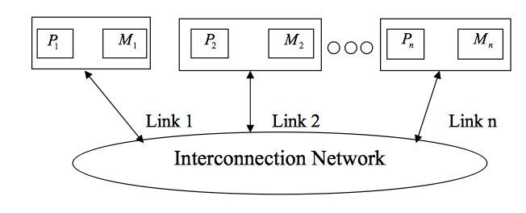
Message Passing Architectures
Communicate data among a set of processors with separate address spaces using messages
High Performance Computing Systems
100-1000+ compute nodes
Complicates compilation

Slide 5
PGAS Languages
Partitioned Global Address Space (PGAS)
Provides illusion of a shared memory system on top of a distributed memory system
Allows the programmer to reason about locality without dealing with low-level data movement
Communication and SPMD style like message passing systems for generated code

Slide 6

CHAPEL
PGAS language developed by Cray Inc.
Programmers express parallelism explicitly
Features to improve programmer productivity
Targets large scale and desktop systems
Opportunities for performance optimizations!

Slide 7
Affine Array Accesses
Most common type of array access in scientific codes
  A[i], A[j], A[3], A[i+1], A[i + j], A[2*i + 3*j]
  A[i, j], A[3*i, 5*j]
Array accesses are affine if the access on each dimension is a linear expression of the loop indices plus a constant term
  E.g. A[ai + bj + c] for a 2D loop nest
  Where a, b, and c are constant integer

Slide 8
Example Parallel Loop in CHAPEL
forall i in 1..10 do
A[i] = B[i+2];
What happens when the data is distributed?
1
2
3
4
5
6
7
8
9
10
11
12
13
14
15
A:
B:

Slide 9
Data Distributions in CHAPEL
Describe how data is allocated across locales for a given program
  A locale is a unit of a distributed computer (processor and memory)
Users can distribute data with CHAPEL’s standard modules or create their own distributions
Distributions considered in this study
  Cyclic
  Block
  Block Cyclic
Notes:
We don’t override the user’s chosen data distribution. This distribution could have been chosen for reasons unknown to the compiler. What we do want to do is improve the compilation for whatever distribution the user did choose.

Slide 10
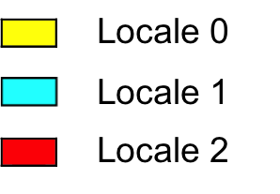
Data Distributions in CHAPEL - Block
use BlockDist;
var domain = {1..15};
var distribution = domain dmapped Block(boundingBox=domain);
var A: [distribution] int;
// A is now distributed in the following fashion
1
2
3
4
5
6
7
8
9
10
11
12
13
14
15
A:

Slide 11
Data Distributions in CHAPEL - Cyclic
use CyclicDist;
var domain = {1..15};
var distribution = domain dmapped Cyclic(startIdx=domain.low);
var A: [distribution] int;
// A is now distributed in the following fashion
1
2
3
4
5
6
7
8
9
10
11
12
13
14
15
A:

Slide 12
Data Distributions in CHAPEL – Block Cyclic
use BlockCycDist;
var domain = {1..15};
var distribution = dom dmapped BlockCyclic(blocksize=3);
var A: [distribution] int;
// A is now distributed in the following fashion
1
2
3
4
5
6
7
8
9
10
11
12
13
14
15
A:
*similar code is used to distributed multi-dimensional arrays

Slide 13
Distributed Parallel Loop in CHAPEL
forall i in 1..10 do
A[i] = B[i+2];
1
2
3
4
5
6
7
8
9
10
11
12
13
14
15
A:
B:
4 Messages
  Locale 1 → Locale 0 containing B[6]
  Locale 1 → Locale 0 containing B[7]
  Locale 2 → Locale 1 containing B[11]
  Locale 2 → Locale 1 containing B[12]

Slide 14
Message Passing is Inefficient in CHAPEL
Locality check at each loop iteration
  Is B[i+2] local or remote?
Each message contains only 1 element
We could have aggregated messages
  Using GASNET strided get/put in CHAPEL
  Locale 1 → Locale 0 containing B[6], B[7]
  Locale 2 → Locale 1 containing B[11], B[12]
Growing problem
  Runtime increases for larger problems and more complex data distributions

Slide 15
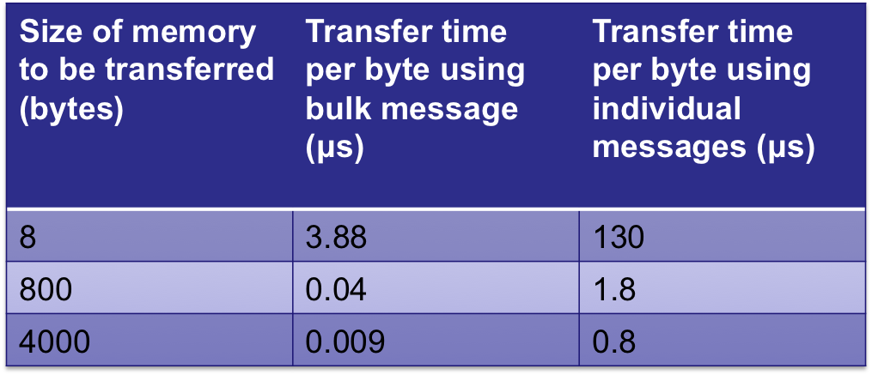
Message Passing is Inefficient in CHAPEL
*measurements taken on an LTS cluster using Infiniband communication link
Notes:
The above chart shows the per-word transfer times of large and small pieces of data using two different methods for messaging: first sending all the data in a single message and second sending individual messages that are each 8 bytes in length. We see that the per-byte transfer time decreases as the size of memory to be transferred becomes larger. We also see that sending messages in bulk is faster than sending messages individually for both large and small amounts of memory. So, aggregating messages will result in faster communication.

Slide 16
How to improve this?
Use knowledge about how data is distributed and loop access patterns to aggregate messages and reduce runtime of affine parallel loops
We are not trying to
  Apply automatic parallelization to CHAPEL
  Come up with a new data distribution
  Bias or override the programmer to a particular distribution
We are trying to
  Improve CHAPEL’s existing data distributions to perform better than their current implementation

Slide 17
Outline
Introduction and Motivation
Previous Work
Modulo Unrolling
Optimized Cyclic and Block Cyclic Dists
Results
What about Block?

Slide 18
Traditional Method – See [4]
Loop fission, fusion, interchange, peeling, etc.
Software pipelining, scheduling, etc.
Pros
  + discovering parallelism
  + increasing the granularity of parallelism
  + improving cache performance
Cons
  not well suited for code generation for message passing machines

Slide 19
Polyhedral Method – See [3]
Boundaries traced for each array use of a loop and intersected with the data distribution
Applied to block distributions
Pros
  + aggregation at compile time for shared memory architectures
  + reduces dynamic runtime locality checks
Cons
  difficult to apply to more complex loops
  does not naturally translate to message passing architectures

Slide 20
PGAS Methods – See [5]
Redundancy elimination, split-phase communication, communication coalescing
Pros
  + eliminates the need for cross thread analysis
  + targets fine-grained communication in UPC compiler
Cons
  No locality analysis that statically determines whether an access is shared or remote

Slide 21
Outline
Introduction and Motivation
Previous Work
Modulo Unrolling
Optimized Cyclic and Block Cyclic Dists
Results
What about Block?

Slide 22
Modulo Unrolling – See [1]
Method to statically disambiguate array accesses at compile time
Unroll the loop by factor = number of locales
Each array access will reside on a single locale across loop iterations
Applicable for Cyclic and Block Cyclic

Slide 23
Modulo Unrolling Example
for i in 1..99 {
A[i] = A[i] + B[i+1];
}
Each iteration of the loop accesses data on a different locale
1
2
3
4
5
6
7
8
9
10
11
12
13
14
15
16
A:
…
B:
…
Locale 3

Slide 24
Modulo Unrolling Example
for i in 1..99 by 4 {
A[i] = A[i] + B[i+1];
A[i+1] = A[i+1] + B[i+2];
A[i+2] = A[i+2] + B[i+3];
A[i+3] = A[i+3] + B[i+4];
}
Loop unrolled by a factor of 4
1
2
3
4
5
6
7
8
9
10
11
12
13
14
15
16
A:
…
B:
…
Locale 3

Slide 25
Modulo Unrolling Example
for i in 1..99 by 4 {
A[i] = A[i] + B[i+1];
A[i+1] = A[i+1] + B[i+2];
A[i+2] = A[i+2] + B[i+3];
A[i+3] = A[i+3] + B[i+4];
}
Locale 0
Locale 1
Locale 2
Locale 3
A[1], A[5], A[9], …
A[2], A[6], A[10], …
A[3], A[7], A[11], …
A[4], A[8], A[12], …
B[1], B[5], B[9], …
B[2], B[6], B[10], …
B[3], B[7], B[11], …
B[4], B[8], B[12], …
1
2
3
4
5
6
7
8
9
10
11
12
13
14
15
16
A:
…
B:
…
Locale 3
How do we apply this concept in Chapel?

Slide 26
Outline
Introduction and Motivation
Previous Work
Modulo Unrolling
Optimized Cyclic and Block Cyclic Dists
Results
What about Block?

Slide 27
CHAPEL Zippered Iteration
Iterators
  Chapel construct similar to a function
  return or “yield” multiple values to the callsite
  Can be used in loops
iter fib(n: int) {
var current = 0,
next = 1;
for i in 1..n {
yield current;
current += next;
current <=> next;
}
}
for f in fib(5) {
writeln(f);
}
Being used in a loop
f is the next yielded value of fib after each iteration
Output: 0, 1, 1, 2, 3

Slide 28
CHAPEL Zippered Iteration
Zippered Iteration
  Multiple iterators of the same size are traversed simultaneously
  Corresponding iterations processed together
Output
Fibonacci 1 = 0
Fibonacci 2 = 1
Fibonacci 3 = 1
Fibonacci 4 = 2
Fibonacci 5 = 3
for (i, f) in zip(1..5, fib(5)) {
writeln(“Fibonacci ”, i, “ = ”, f);
}

Slide 29
CHAPEL Zippered Iteration
Can be used with parallel for loops
Leader iterator
  Creates tasks to implement parallelism and assigns iterations to tasks
Follower iterator
  Carries out work specified by leader (yielding elements) usually serially

Slide 30
CHAPEL Zippered Iteration
Follower iterators of A, B, and C will be
responsible for doing work for each task
forall (a, b, c) in zip(A, B, C) {
code…
}
Because it is first, A’s leader iterator
will divide up the work among available tasks
*See [2] for more detail on leader/follower semantics

Slide 31
CHAPEL Zippered Iteration
It turns out any parallel forall loop with affine array accesses can be written using zippered iteration
forall i in 1..10 {
A[i] = B[i+2];
}
forall (a,b) in zip(A[1..10], B[3..12]){
a = b;
}
Zippered iteration
Implement modulo unrolling and message aggregation within the leader and follower iterators of the Block Cyclic and Cyclic distributions!

Slide 32
Modulo Unrolling in CHAPEL Cyclic Distribution
forall (a,b) in zip(A[1..10], B[3..12] do
a = b;
1
2
3
4
5
6
7
8
9
10
11
12
13
14
15
16
A:
…
B:
…
Locale 3
*if yielded elements are written to during the loop, a similar bulk put message is required to update remote portions of array
Leader iterator allocates locale 0 with iterations 1, 5, 9, …
Follower iterator of B recognizes that its work 3, 7, 11, … is remote on locale 2
Elements of B’s chunk of work brought to locale 0 via 1 bulk get message to a local buffer
Elements of local buffer are now yielded back to loop header
Locale 0

Slide 33
Modulo Unrolling in CHAPEL Block Cyclic Distribution
forall (a,b) in zip(A[1..10], B[3..12] do
a = b;
1
2
3
4
5
6
7
8
9
10
11
12
13
14
15
16
A:
…
B:
…
Locale 3
Aggregation now occurs with elements in the same location within each block
Both leader and follower needed to be modified
Locale 0

Slide 34
Outline
Introduction and Motivation
Previous Work
Modulo Unrolling
Optimized Cyclic and Block Cyclic Dists
Results
What about Block?

Slide 35
Benchmarks
Name | Description | Input (elements)
2mm | 2-d matrix multiplication | 128 x 128
cholesky | 2-d Cholesky decomposition | 128 x 128
jacobi | 2-d Jacobi relaxation | 400 x 400
stencil9 | 2-d 9-point stencil calculation | 400 x 400
folding | Sum consecutive elements of array using strided access pattern (1-d) | N = 50400, 10 iterations
pascal | Computes rows of pascal’s triangle | N1 = 999, N2 = 1002
* Data collected on 10 locale machine

Slide 36
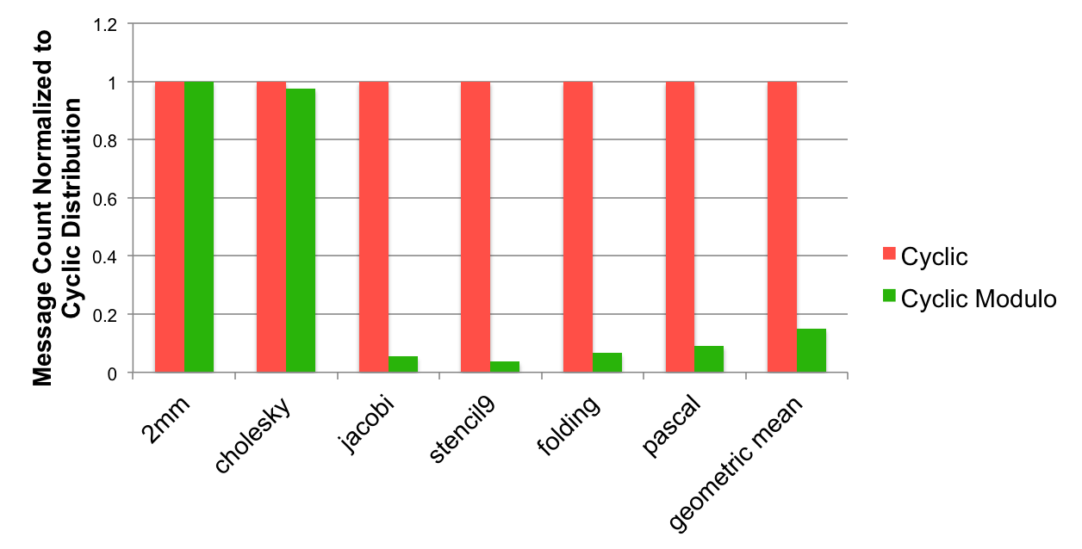
Comparing Cyclic Modulo Unrolling with Existing Distributions
*Data collection is still a work in progress

Slide 37
Outline
Introduction and Motivation
Previous Work
Modulo Unrolling
Optimized Cyclic and Block Cyclic Dists
Results
What about Block?

Slide 38
What about Block?
It seems that data distributed using Block naturally results in fewer messages for many benchmarks
Makes sense because many benchmarks in scientific computing access nearest neighbor elements
Nearest neighbor elements are more likely to reside on the same locale
Could we still do better and aggregate messages?

Slide 39
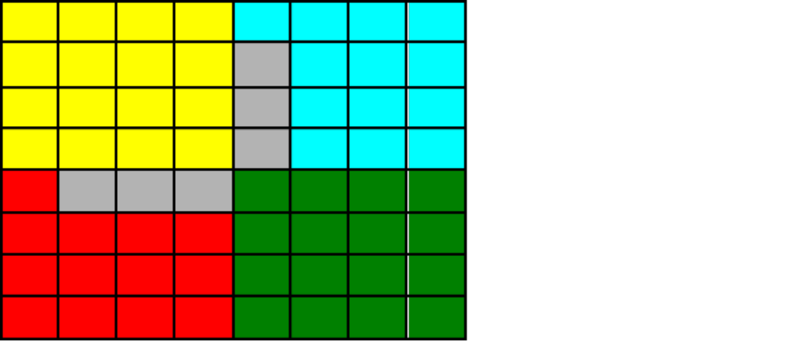
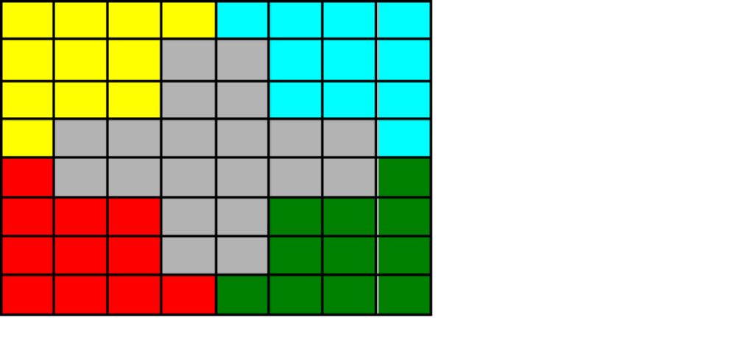
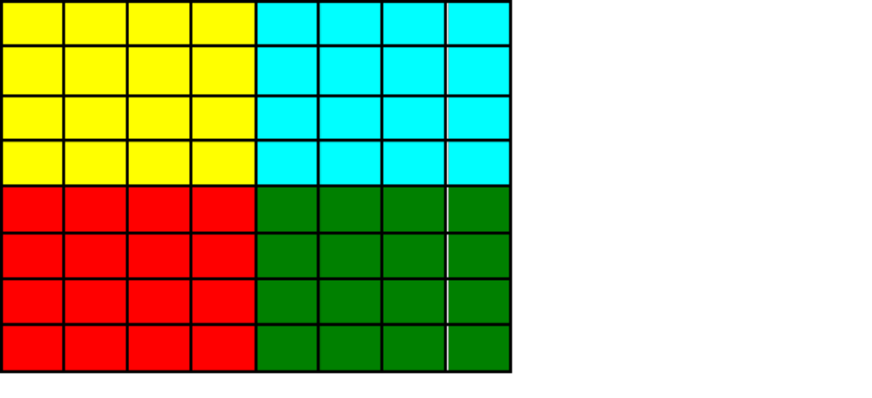
What about Block?
2D Jacobi Example
i
1
2
3
4
5
6
7
8
1
2
j
3
4
5
Locale 3
6
7
8
A[i, j-1]
A[i-1, j]
A[i, j]
A[i+1, j]
forall (i,j) in {2..7, 2..7} {
A_{new}[i,j] = (A[i+1, j] + A[i-1, j] + A[i, j+1] + A[i, j-1])/4.0;
}
A[i, j+1]

Slide 40
What about Block?
2D Jacobi Example – Transformed Pseudocode
For each block in parallel
forall (k1,k2) in {0..1, 0..1} {
if A[2 + 3k1, 2 + 3k2].locale.id == $ then on $ {
buf_north = get(A[2+3k1..4+3k1, 2+3k2-1..4+3k2-1]);
buf_south = get(A[2+3k1..4+3k1, 2+3k2+1..4+3k2+1]);
buf_east = get(A[2+3k1-1..4+3k1-1, 2+3k2..4+3k2]);
buf_west = get(A[2+3k1+1..4+3k1+1, 2+3k2..4+3k2]);
LB_i = 2+3k1;
LB_j = 2+3k2;
forall(i, j) in {2+3k1..4+3k1, 2+3k2..4+3k2} {
A_{new}[i,j] = (buf_north[i-LB_i, j-LB_j] + buf_south[i-LB_i, j-LB_j] +
buf_east[i-LB_i, j-LB_j] + buf_west[i-LB_i, j-LB_j])/4.0;
}
}
Bring in remote
portions of array
footprint locally
Do the computation using local buffers

Slide 41
Conclusion
We’ve presented optimized Cyclic and Block Cyclic distributions in Chapel that perform modulo unrolling
Our results for Cyclic Modulo are comparable with CHAPEL’s existing Block distribution
Average message count reductions normalized to Cyclic
  Cyclic Modulo: 0.151

Slide 42
References
[1] Barua, R., & Lee, W. (1999). Maps: A Compiler-Managed Memory System for Raw Machine. Proceedings of the 26th International Symposium on Computer Architecture, (pp. 4-15).
[2] User-Defined Parallel Zippered Iterators in Chapel, Chamberlain, Choi, Deitz, Navarro; October 2011
[3] M.-W. Benabderrahmane, L.-N. Pouchet, A. Cohen, and C. Bastoul. The polyhedral model is more widely applicable than you think. In ETAPS International Conference on Compiler Construction (CC’2010), pages 283–303, Mar. 2010.

Slide 43
References
[4] Compile-time techniques for data distribution in distributed memory machines. J Ramanujam, P Sadayappan - Parallel and Distributed Systems, IEEE Transactions on, 1991
[5] Chen, Wei-Yu, Costin Iancu, and Katherine Yelick. "Communication optimizations for fine-grained UPC applications." Parallel Architectures and Compilation Techniques, 2005. PACT 2005. 14th International Conference on. IEEE, 2005.

Slide 44
Questions?

